Slide 1
Written English: Business Letters

Slide 2
Summary
Introduction
The Seven Cs of Letter Writing
Significance
Purpose

Slide 3
'Letter writing is the only device for combining solitude with good company.'
–Lord Byron

Slide 4
Introduction
Formal written communication includes business interactions…
Requires a strong command over language…
The target audience…
In letter writing, precision and clarity of meaning are extremely important.
The reader creates an image of the writer or the organization through their letters.
It should keep to the facts and be easy to read and understand.

Slide 5
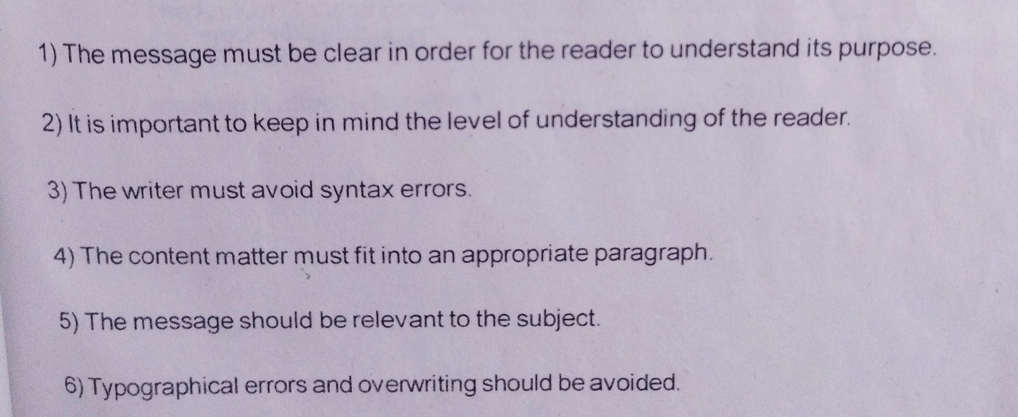
Pre-Requisites of Written Communication

Slide 6
The Seven Cs of Letter Writing
Clarity
Conciseness
Correctness
Courtesy
Cordiality
Conviction
Completeness

Slide 7
Significance
Just as personal letters help maintain personal relationship with friends and relatives, formal letters assist in sustaining relationships with other organizations, clients, and vendors.
They are the appropriate forms of communication when the information to be conveyed is complex.
They serve as permanent records and are a valuable repository of information, which can be referred to in future.
They help reach out to a large and geographically diverse audience economically.

Slide 8
Purpose
To inform
To enquire
To request
To complain
To sell a product, service, or scheme
To congratulate
To order
To collect dues
To make an adjustment
To apply for a job

Slide 9
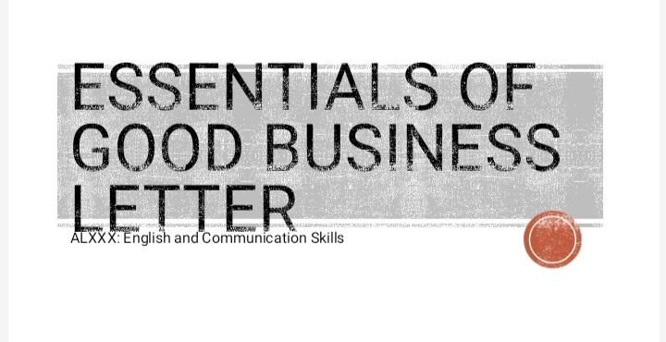

Slide 10
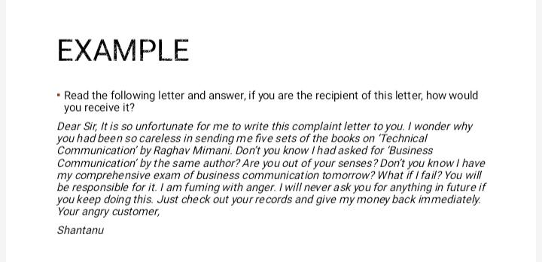

Slide 11
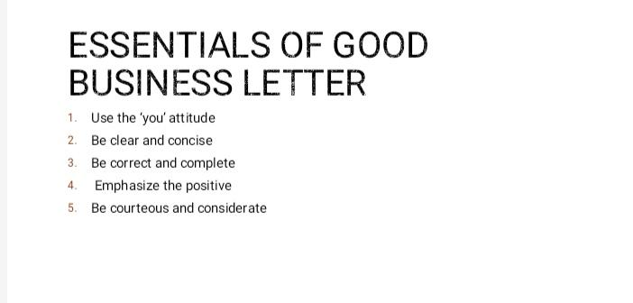

Slide 12
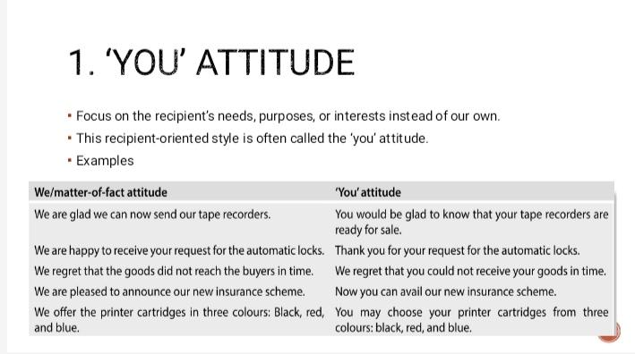

Slide 13
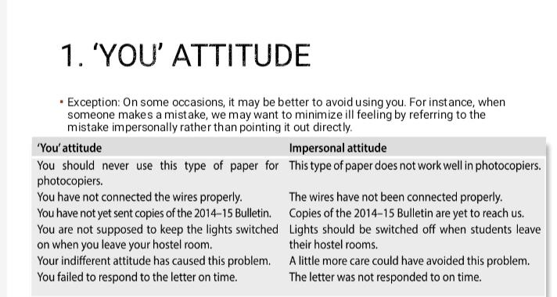

Slide 14
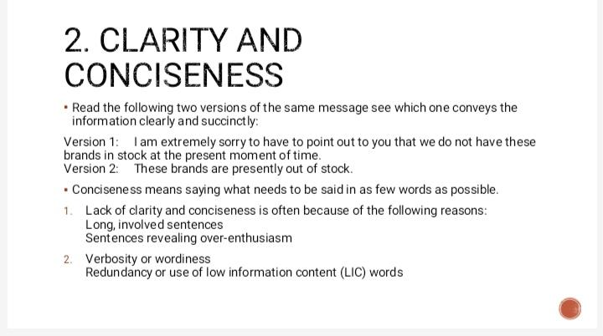

Slide 15
Long phrases can be avoided for conciseness
in order to
as a matter of fact
in spite of the fact that
at all times
at the present time
in the final analysis
at this point in time
because of the fact that
due to the fact that
in the near future
for the purpose of
have the ability to
enclosed please find

Slide 16
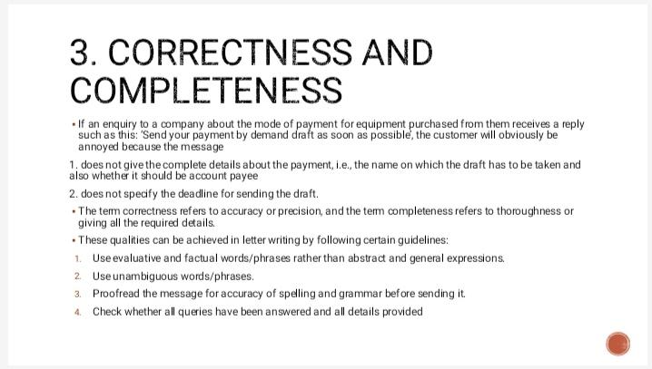

Slide 17
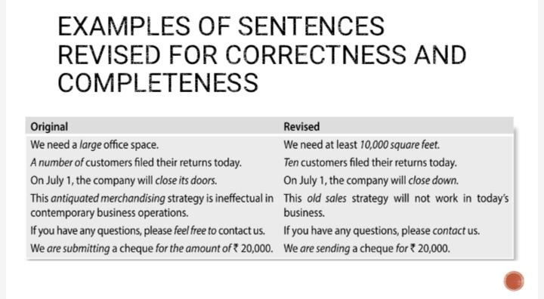

Slide 18
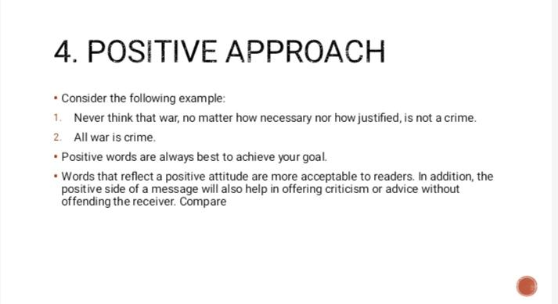

Slide 19
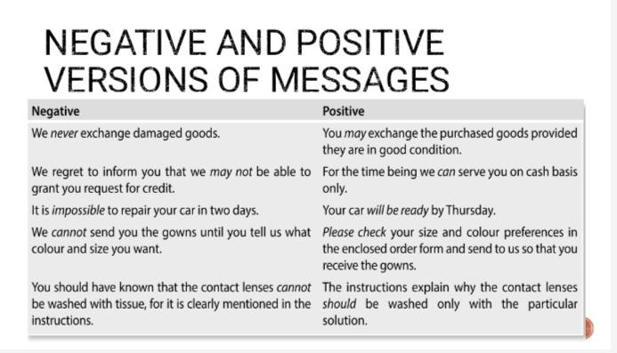

Slide 20
Replacements for offending word/phrases
elderly
second-hand cars
cheap goods
toilet paper
high-calorie food
you’re being fired
global warming
servant
dull
poor people
What’s the problem?
disabled

Slide 21
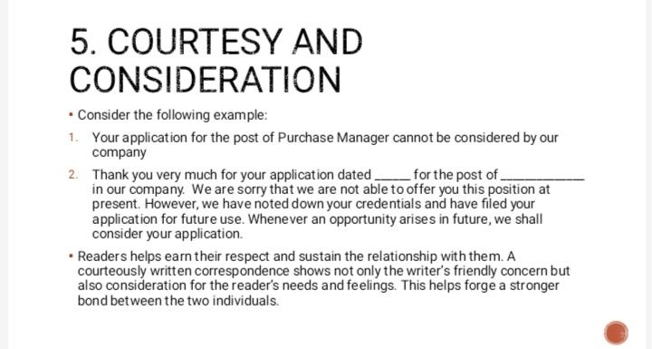
We appreciate your interest in working with us. Our best wishes to you.

Slide 22
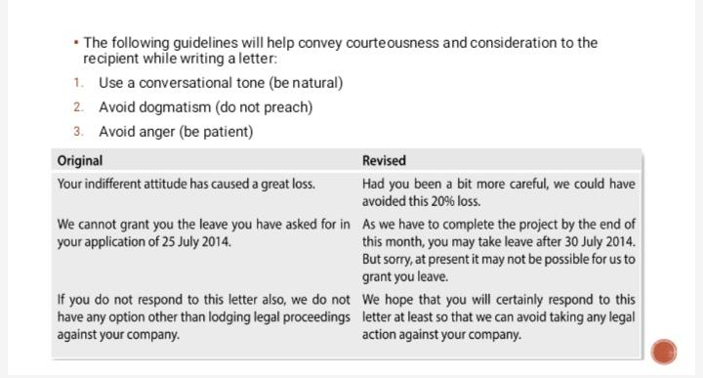

Slide 23
Avoid Using Cliches and Jargons
Since a letter requires strong, positive, and emphatic structure, using some empty cliches and jargon in a letter is likely to make it sound weak and ineffective. Given below are some such expressions which need to be avoided.
The writer begs to acknowledge the receipt of…
The favour of your early reply will be appreciated by us.
Enclosed please find herewith…
Awaiting the favour of your early reply.
Assuring you of our best possible services and attention at all times.
I have the pleasure of informing you…
Please be good enough to advise us further on this.

Slide 24
